Slide 1



Lions CLUB International Peace Poster contest
RSA Student Finalists
for the
Redding Area Lions Clubs

Slide 2

Redding Breakfast Lions Club
“Journey of Peace”
1st: Hayden Tucker, 6th
2nd: Carmin Lemos, 7th
3rd: Kyle Wells, 7th

Slide 3
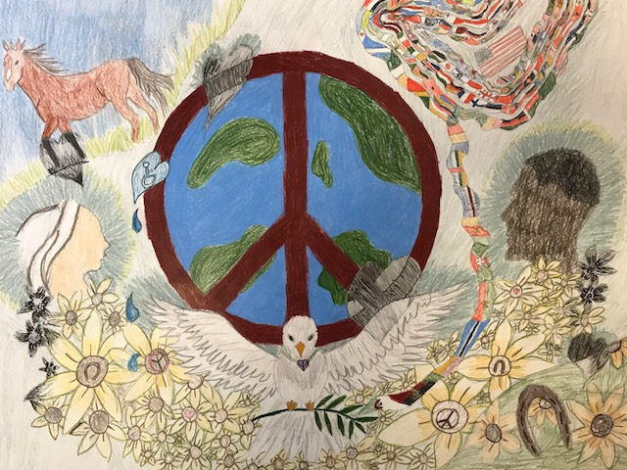
1st: Hayden Tucker, 6th

Slide 4
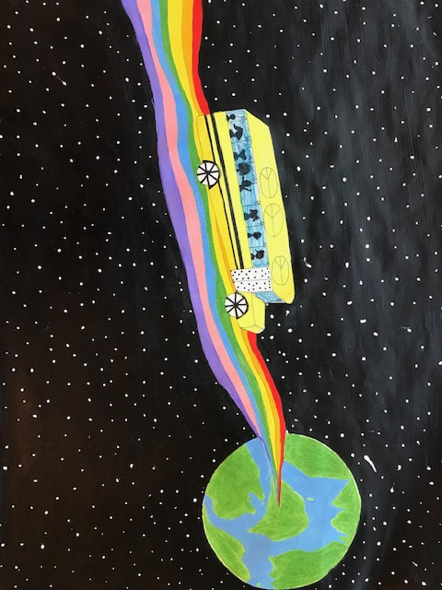
2nd: Carmin Lemos, 7th

Slide 5
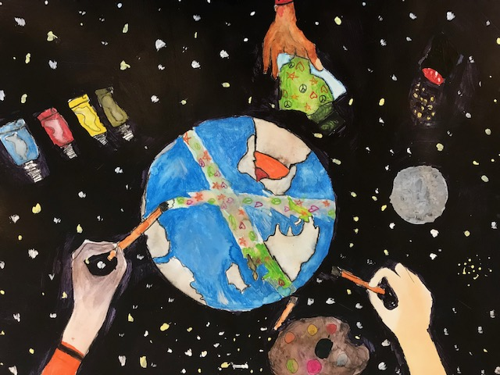
3rd: Kyle Wells, 7th

Slide 6
Enterprise Lions Club
“Journey of Peace”
1st: Lily Fano, 7th
2nd: Anabella Hewlett, 8th
3rd: Evangelyn Verhey, 8th

Slide 7
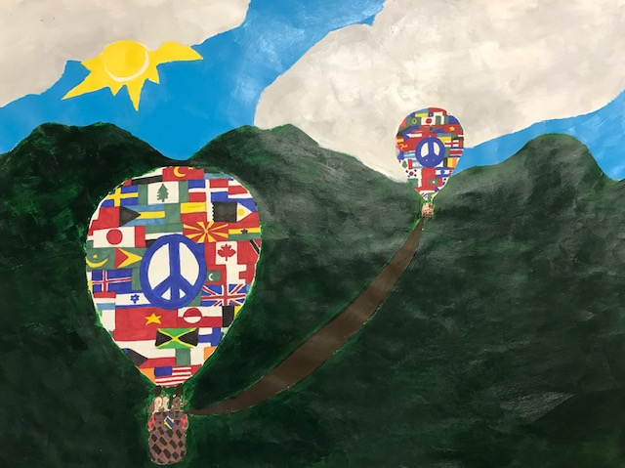
1st: Lily Fano, 7th

Slide 8
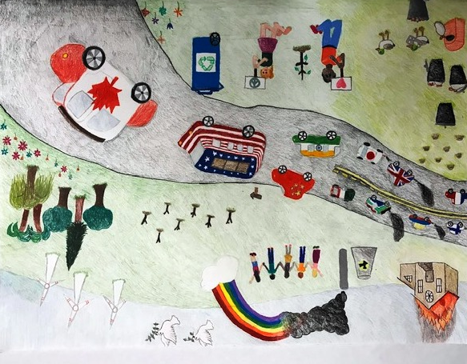
2nd: Anabella Hewlett, 8th

Slide 9
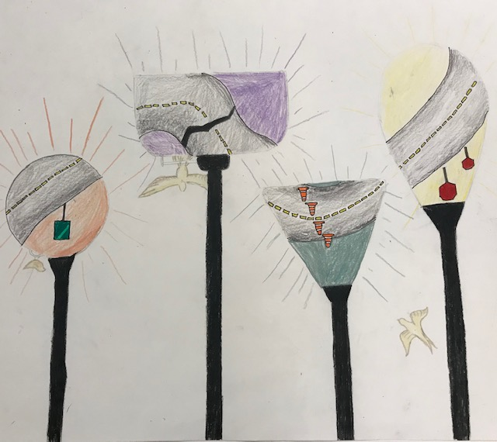
3rd: Evangelyn Verhey, 8th

Slide 10
Redding Host Lions Club
“Journey To Peace”
1st: Raine Zimmer, 6th
2nd: Clara Pargett, 8th
3rd: DaXi Dillon-Foulk, 8th

Slide 11
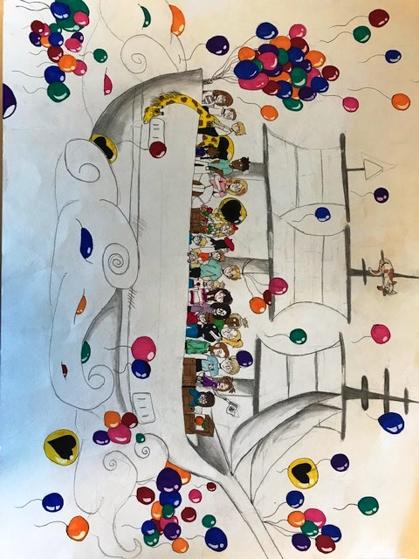
1st: Raine Zimmer, 6th

Slide 12
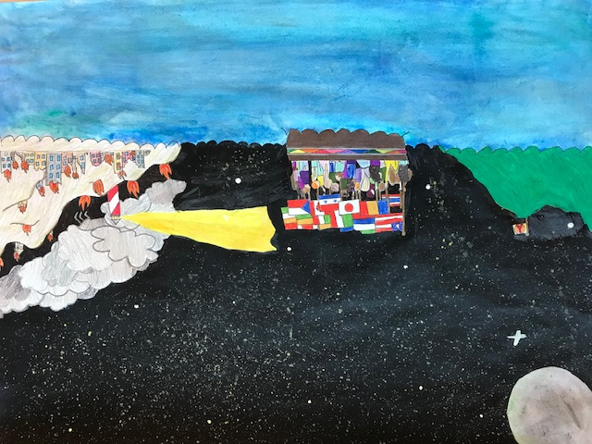
2nd: Clara Pargett, 8th

Slide 13
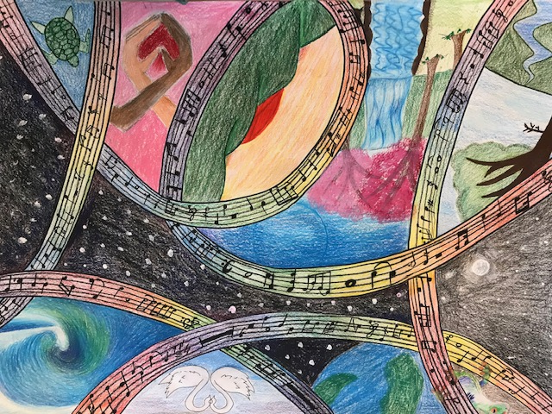
3rd : DaXi Dillion-Foulk

Slide 14
Shasta Lake Lions Club
“Journey To Peace”
1st: Fabiana Fadda, 8th
2nd: Quincy Barber, 6th
3rd: Madelyn Kimple, 8th

Slide 15
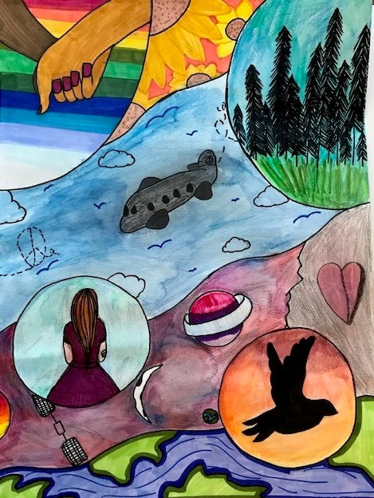
1st: Fabiana Fadda, 8th

Slide 16
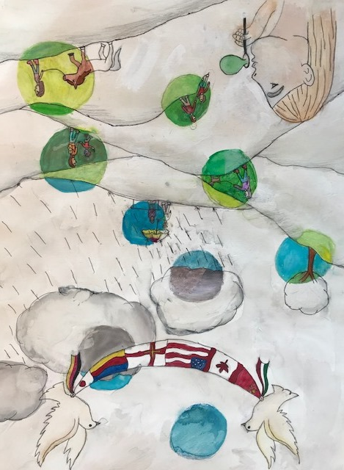
2nd: Quincy Barber, 6th

Slide 17
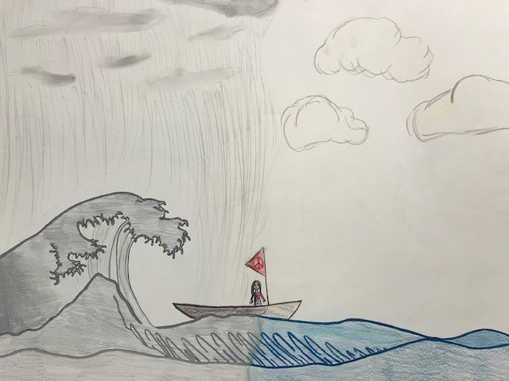
3rd: Madelyn Kimple, 8th

Slide 18
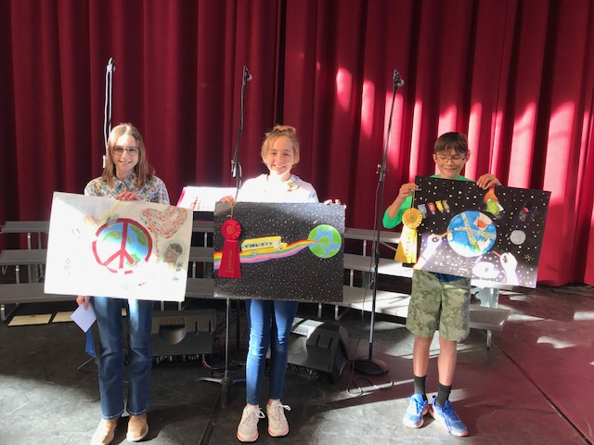
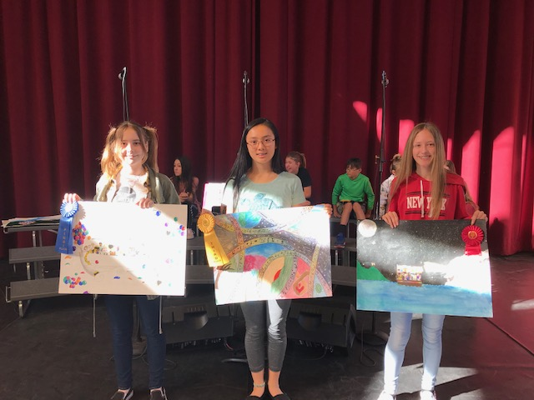
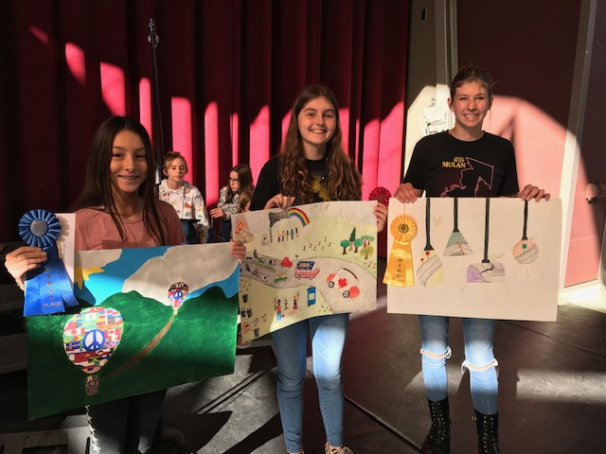
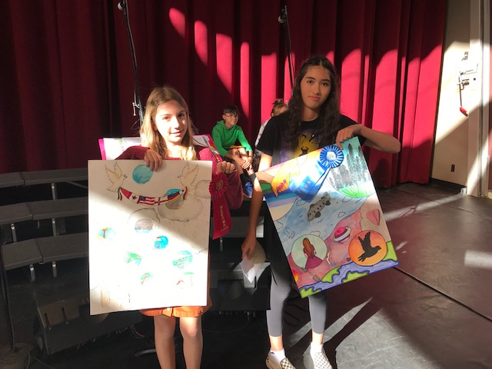
2019 PEACE POSTER WINNERS

Slide 19
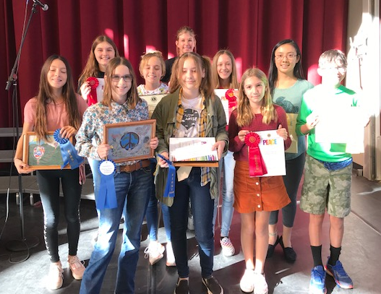
RSA Artists Begin Their Journey to Peace

